Slide 1

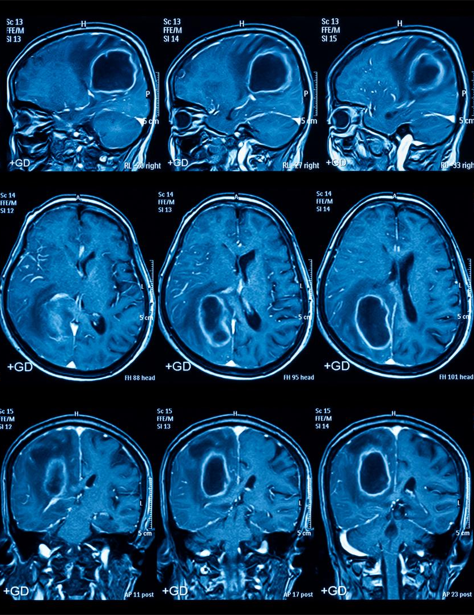




MEDICAL IMAGE
SEGMENTATION
WITH
Deependra Dewagiri - 200119C

Slide 2

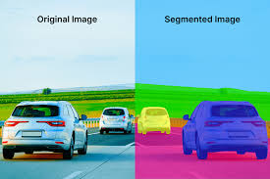
What is image segmentation?
Simplifying an image to meaningful pixel groups.
Partitioning an image into parts for deriving meaning or further analysis based on some homogenous visual characteristics
Source : EN3160 - Image Processing and Machine Vision,Dr.Ranga Rodrigo

Slide 3
Image segmentation techniques
Thresholding
Edge-Based Segmentation
Region-Based Segmentation
Clustering-Based Segmentation
Machine Learning / Deep Learning - Based Segmentation

Slide 4
Region-Based Segmentation
Region Growing
Watershed Algorithm

Slide 5
Region Growing

Slide 6
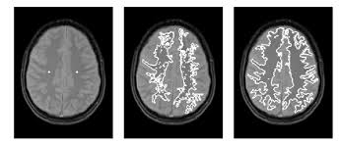
Region Growing
Starts with a seed point and grows the region by adding neighboring pixels that satisfy a inclusion criteria.
https://sbme-tutorials.github.io/2019/cv/notes/6_week6.html

Slide 7
Region Growing
Starts with a seed point and grows the region by adding neighboring pixels that satisfy a inclusion criteria.
https://sbme-tutorials.github.io/2019/cv/notes/6_week6.html

Slide 8
Region Growing
Starts with a seed point and grows the region by adding neighboring pixels that satisfy a inclusion criteria.
https://sbme-tutorials.github.io/2019/cv/notes/6_week6.html

Slide 9
Region Growing
Connected Threshold
Otsu Segmentation
Neighborhood Connected
Confidence Connected
Isolated Connected
Vector Confidence Connected

Slide 10
Region Growing : Connected Threshold
Input Preparation: CurvatureFlowImageFilter to reduce noise while preserving edges
Threshold Setting: Lower and upper intensity thresholds.
Region Growing: All connected pixels within the threshold range, starting from the seed point.
Binary Output: A binary image

Slide 11
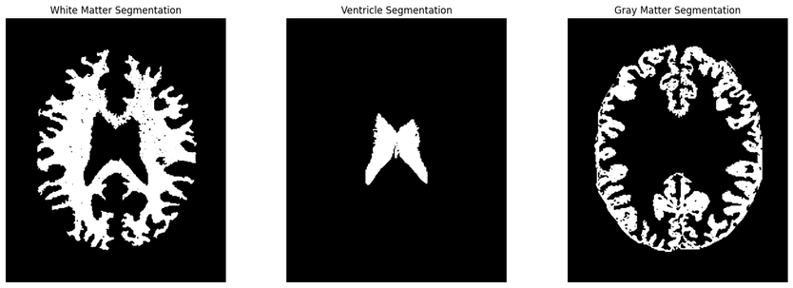
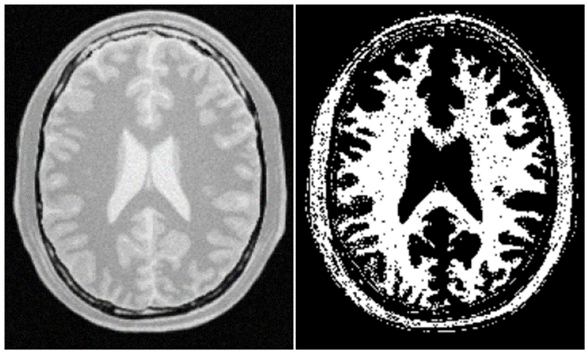
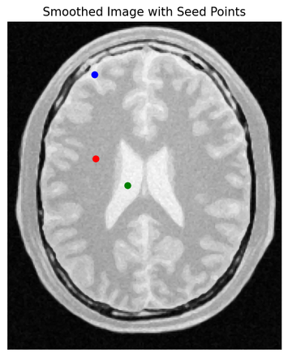

Region Growing : Connected Threshold
segmented image 1
original image
segmented image 2
original image
smoothed image
segmented image 3

Slide 12
Region Growing : Otsu Segmentation
Histogram Generation: Determines the distribution of pixel intensities in the image.
Otsu's Method: Otsu's method to determine the optimal threshold values that maximize inter-class variance.
Binary Thresholding: Thresholding is applied to segment the image into different regions based on these thresholds.

Slide 13
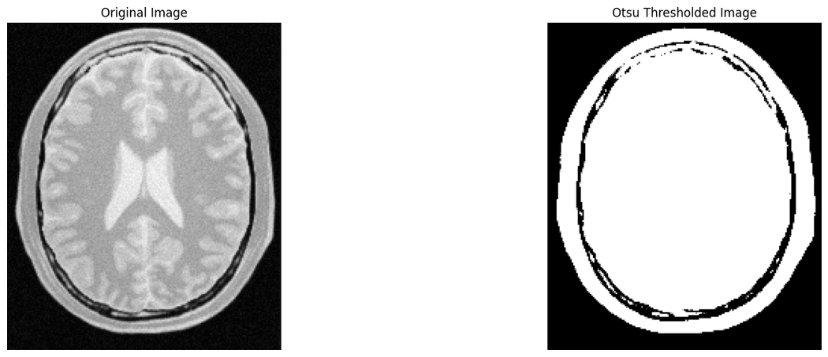
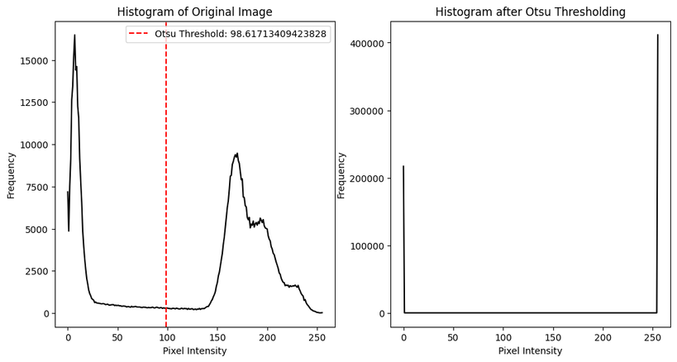
Region Growing : Otsu Segmentation

Slide 14
Region Growing : Neighborhood Connected
Edge-Preserving Smoothing: Smoothing the image while preserving important edges
Neighborhood Radius: Size of the region around each pixel that will be evaluated
Segmentation Process: reduces the chances of including small, isolated structures.

Slide 15
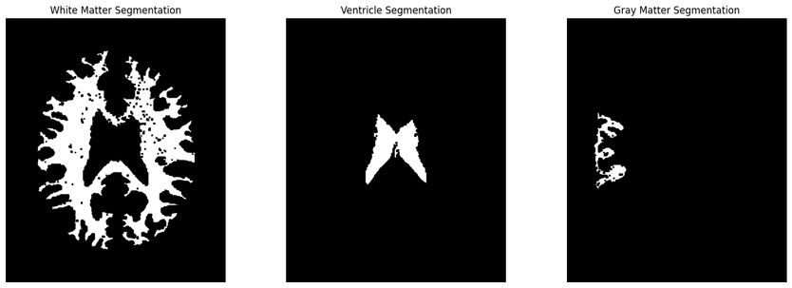

Region Growing : Neighborhood Connected
segmented image 1
original image
segmented image 2
original image
smoothed image
segmented image 3

Slide 16
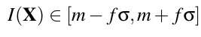
Region Growing : Confidence Connected
Edge-Preserving Smoothing: Smoothing the image while preserving important edges
Statistical Criterion: Compute the mean and standard deviation of the intensity values for all the pixels included in the region
Parameters:
Multiplier (f): Controls the size of the intensity range.
Number of Iterations: The number of times the mean and standard deviation are recalculated.
Initial Neighborhood Radius:

Slide 17
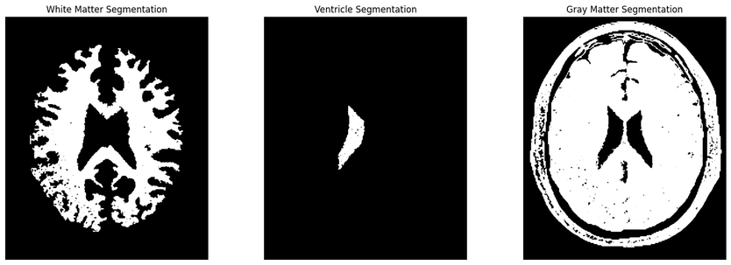

Region Growing : Confidence Connected
segmented image 1
original image
segmented image 2
original image
smoothed image
segmented image 3

Slide 18
Region Growing : Isolated Connected
Edge-Preserving Smoothing: Smoothing the image while preserving important edges
Two Seed Points: One seed (Seed1) is used to grow a region, and the other seed (Seed2) is used to define a region that should not be connected to the first region.
Binary Search for Upper Threshold

Slide 19
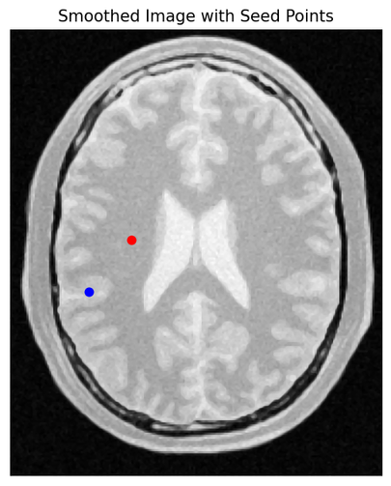
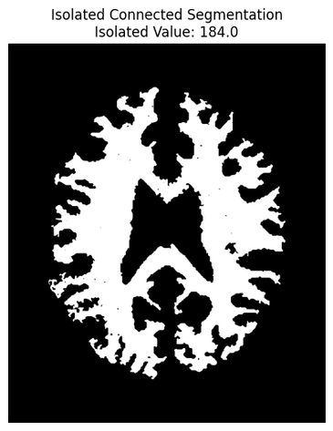
Region Growing : Isolated Connected
original image
smoothed image
segmented image

Slide 20
Region Growing : Vector Confidence Connected
Vector Pixel Data Types: RGB
Covariance and Mean: Relationships between different components of the pixel vectors
Mahalanobis Distance : Measure how far a pixel's vector is from the region's mean.

Slide 21
Region Growing : Vector Confidence Connected
Segmentation Approach:
Segments an image by iteratively expanding a region starting from an initial seed point.
mean vector and covariance matrix of the pixel values within the region.
A pixel is included in the region if its Mahalanobis distance from the region's mean is within a user-defined threshold.

Slide 22
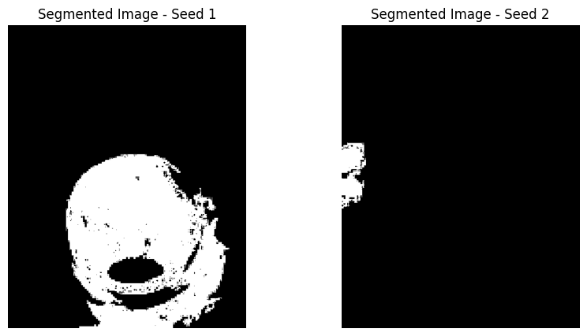
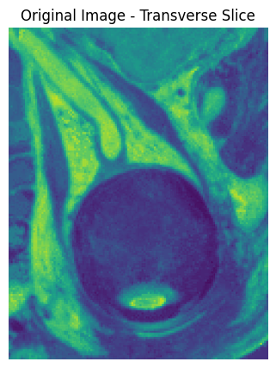
Region Growing : Vector Confidence Connected
segmented image 1
segmented image 2
original image

Slide 23
Watershed Segmentation

Slide 24
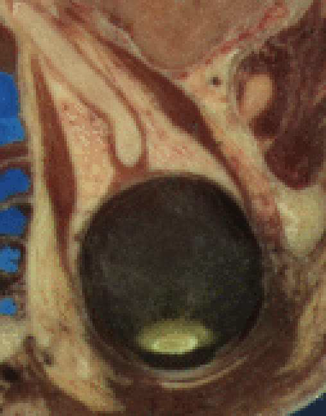
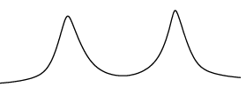
Watershed Segmentation : Key Concepts
Topographic Surface Interpretation:
The image is seen as a landscape, where higher intensity values correspond to peaks and lower values to valleys.
original image
Intensity profile of input image

Slide 25
Watershed Segmentation : Key Concepts
Catchment Basins:
Each local minimum in the image creates a basin, and pixels are classified based on which basin they belong to
Intensity profile of image
Basins

Slide 26

Watershed Segmentation : Intuition
Intensity profile
of input image

Slide 27
Watershed Segmentation : Intuition
Intensity profile
of input image
Intensity profile
of filtered image

Slide 28
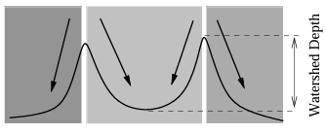
Watershed Segmentation : Intuition
Intensity profile
of input image
Intensity profile
of filtered image
Segmented Image

Slide 29
Watershed Segmentation : Key Points
Gradient-Based Segmentation: Uses the gradient magnitude of the image
Preprocessing with Filters: Edge-preserving smoothing filters(anisotropic diffusion or bilateral filters)
Threshold and Level Parameters:
The threshold parameter controls the minimum height difference between the local minima and their boundaries, merging shallow basins into larger regions.
The level parameter determines the watershed depth, influencing how the regions are defined.

Slide 30
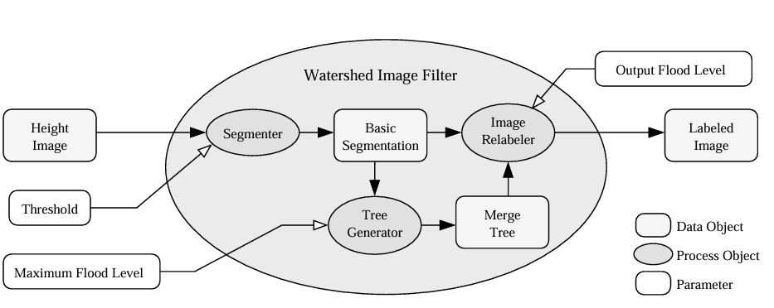
Watershed Segmentation : Outline
Source : ITK Documentation
Notes:
Height Image: This is the input image, where pixel intensities are interpreted as heights in a topographic surface. It serves as the primary data object that represents the landscape to be segmented.
Segmenter: This process object performs the basic segmentation. It takes the height image and analyzes the landscape to identify catchment basins (local minima) and regions, where pixels "flow" towards the same minimum. It is the initial step in creating the segmentation.
Threshold: This parameter controls which regions are retained during segmentation. A higher threshold eliminates smaller, less significant regions to prevent over-segmentation.
Maximum Flood Level: defines the maximum depth for which the algorithm should continue merging regions.
helps manage how deep the catchment basins should be before being merged with adjacent basins.
Basic Segmentation: This data object represents the initial segmentation output by the segmenter. It contains many small, over-segmented regions.
Tree Generator: This process object generates a hierarchical structure (or merge tree) from the segmented regions. It identifies the relationships between smaller basins and larger ones.
Merge Tree: This is a data object that organizes the segmented regions into a hierarchy, where larger regions contain smaller ones. It helps control the merging process.
Image Relabeler: This process object takes the basic segmentation and uses the merge tree to combine regions based on the specified parameters (threshold and maximum flood level). It re-labels the segments to produce a more meaningful, less over-segmented output.
Output Flood Level: This parameter indicates the current level of flooding during the watershed process and allows for adjustments to be made at different levels of hierarchy.
Labeled Image: This is the final output, which is a segmented image where each region is labeled with a unique identifier. This image is typically used for further analysis or visualization.

Slide 31

Watershed Segmentation
original image
segmented image

Slide 32
THANK
YOU

